Slide 1




Information Technology Institute - ITI
Data Engineering Track - R1 2025
EGYPTIAN STOCK MARKET
DATA PIPELINE
December 13th , 2025
Date

Slide 2






Information Technology Institute - ITI
Data Engineering Track - R1 2025
Our Team
Aalaa Hamam
Eslam Shatto
Ahmed Arnos
Ahmed Elsaba
Karim Yasser

Slide 3
Agenda
1. Introduction :
Business Overview : The Challenge.
2. The Business & Value
Business Solution
Business Value
Target Users
3. The Technical Deep Dive
Data Architecture Overview
Batch Processing Pipeline
Streaming Pipeline
4. Data Transformation & Orchestration
dbt Transformation
Airflow Orchestration
5. Conclusion
Visualization
Future work

Slide 4





BUSINESS OVERVIEW
The Problem: Fragmented and Delayed Data
Data Silos
Stale Decision-Making
Low Data Trust
The Requirement

Slide 5
THE SMART SOLUTION: SPEED AND TRUST
Our Approach: Automated Data Pipeline
Real-time Speed:
Streams live EGX market updates every 30 sec .
Historical Depth:
Loads all archived data from S3 daily.
Analysts get a full, reliable picture of the market.
Automation:
Airflow runs all data processes automatically and on
schedule.
This lets analysts focus on making decisions, not
cleaning data

Slide 6
3. THE BUSINESS VALUE: FASTER DECISIONS, LOWER RISK
SMARTER INVESTMENT:
Use analytical data (Gold Layer) directly for powerful insights and predictive models.
React immediately to real-time market changes.
HIGH EFFICIENCY:
Airflow automation eliminates manual data preparation.
Analysts save time and focus only on strategy and analysis.
DATA CONFIDENCE:
Data Quality Tests ensure the data is reliable and accurate.
Investment decisions are based on solid, validated facts.

Slide 7


4. TARGET USERS: WHO BENEFITS?
Investment Analysts : Access to cleaned, ready-to-use data (Gold Layer) for deep stock analysis.
Data Scientists : A consistent, high-quality data feed for training machine learning and prediction models.
Executive Leadership : Fast, unified reports for strategic planning and major investment decisions.
Retail Investors : Indirectly benefit from real-time charts and simplified reports powered by the Gold Layer data.

Slide 8
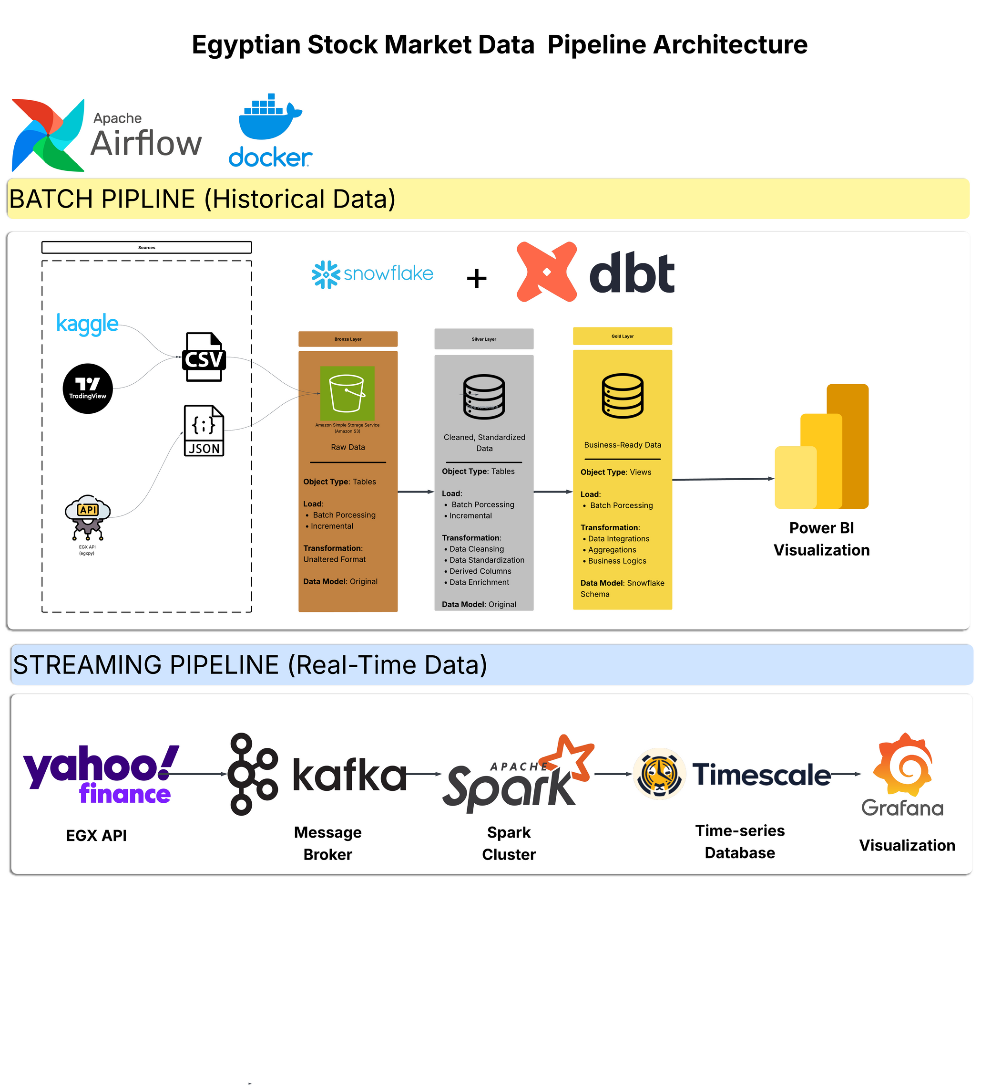

End-to-End Pipeline Architecture

Slide 9
End-to-End Pipeline Architecture
S3 Batch Data (Historical):
Historical data is sourced from Web Scraping and Kaggle-ready archives, stored in S3 as CSV file
EGX API & Kafka Producer (Real-time):
Live data for 249 companies is fetched via egxpy and ingested rapidly using Kafka
DBT Transformations:
Transforms raw data into analytical models (Silver and Gold layers).
Snowflake Data Warehouse:
The central, scalable destination for both streaming and batch data.
Power BI : Creates dashboards for operations, finance, etc.
Airflow : Orchestrates all tasks
Docker : Containerizes everything

Slide 10

Batch Layer
Pipeline Orchestration
Check S3
Extract
Load
Quality
Notify
DBT Test
Gold Transform
Silver Transform

Slide 11
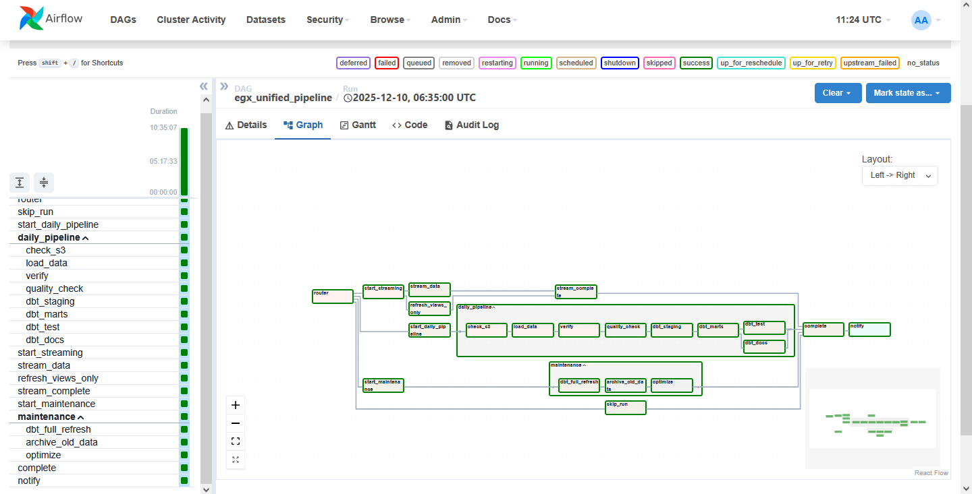
Full Architecture Overview

Slide 12
BATCH LAYER TECHNOLOGY

Slide 13
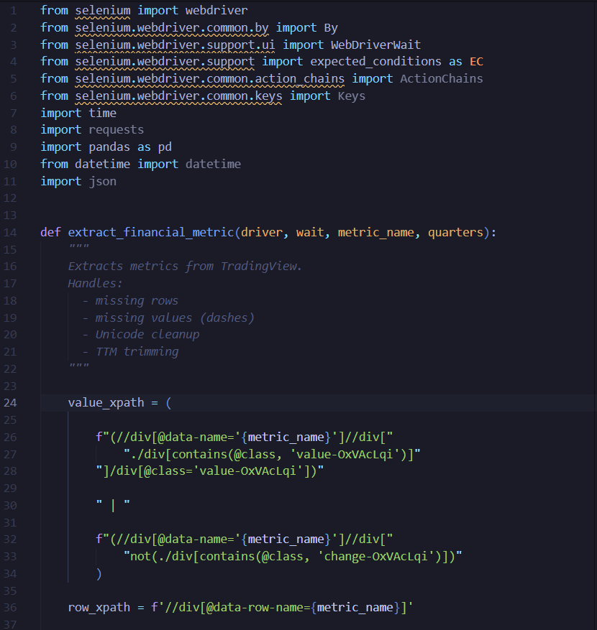
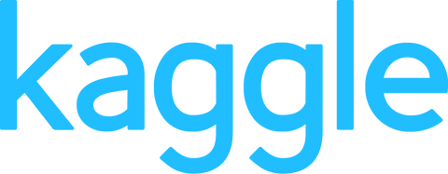


Batch Layer
Data Ingestion

Slide 14
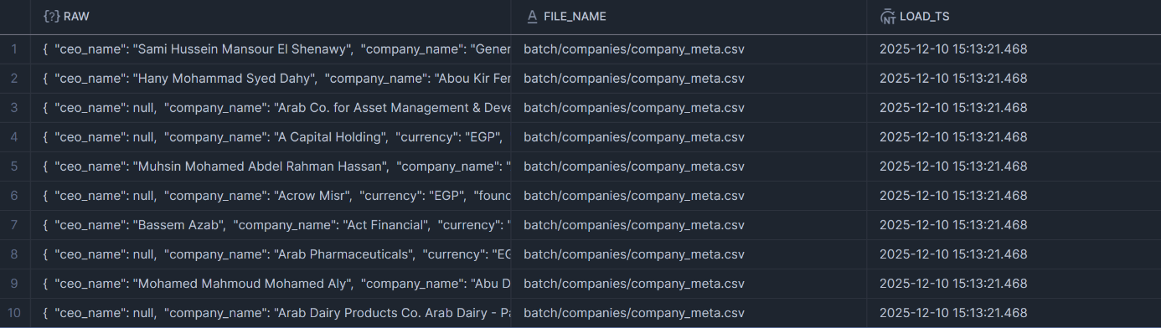
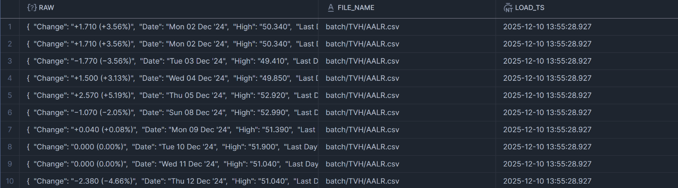
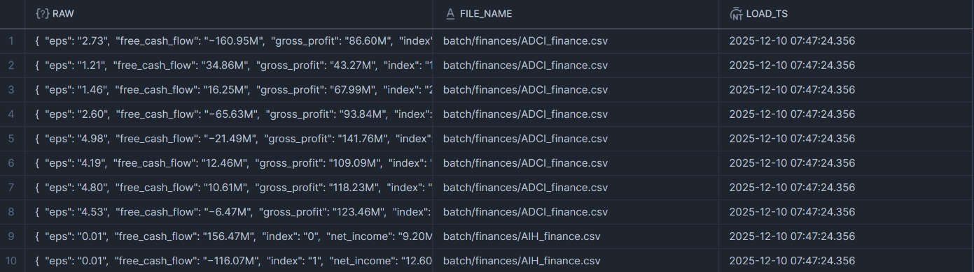
Bronze

Slide 15
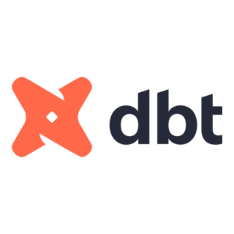

MAJOR TRANSFORMATIONS:
Batch Layer
Silver Layer
Data Cleansing: Standardizing strings (Trimming) and removing excess whitespaces.
Value Unification: Ensuring consistent formatting for Dates, Numbers, and Currencies.
Error Handling: Managing NULL values and eliminating all record Duplications.
Goal: Producing reliable and clean data assets ready for the Gold Layer analysis.

Slide 16
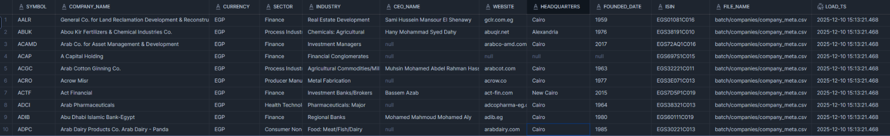
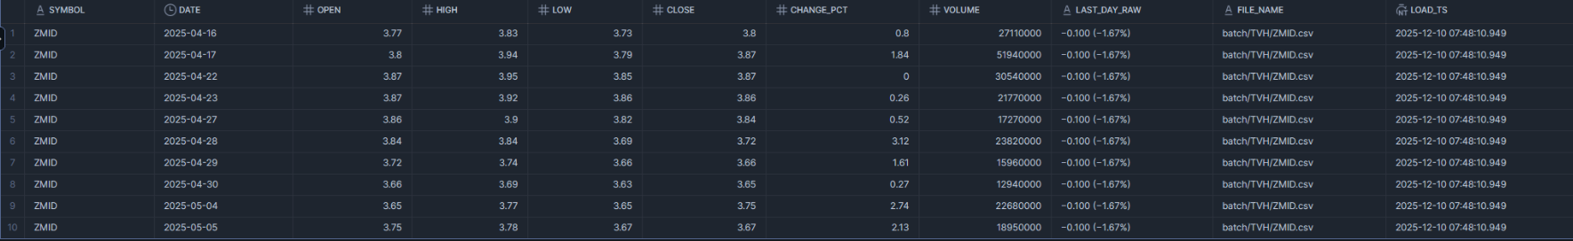
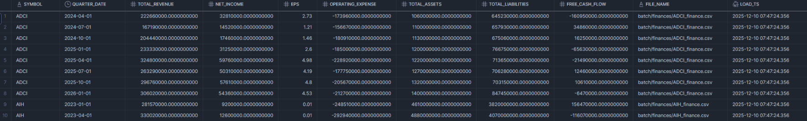
Silver

Slide 17
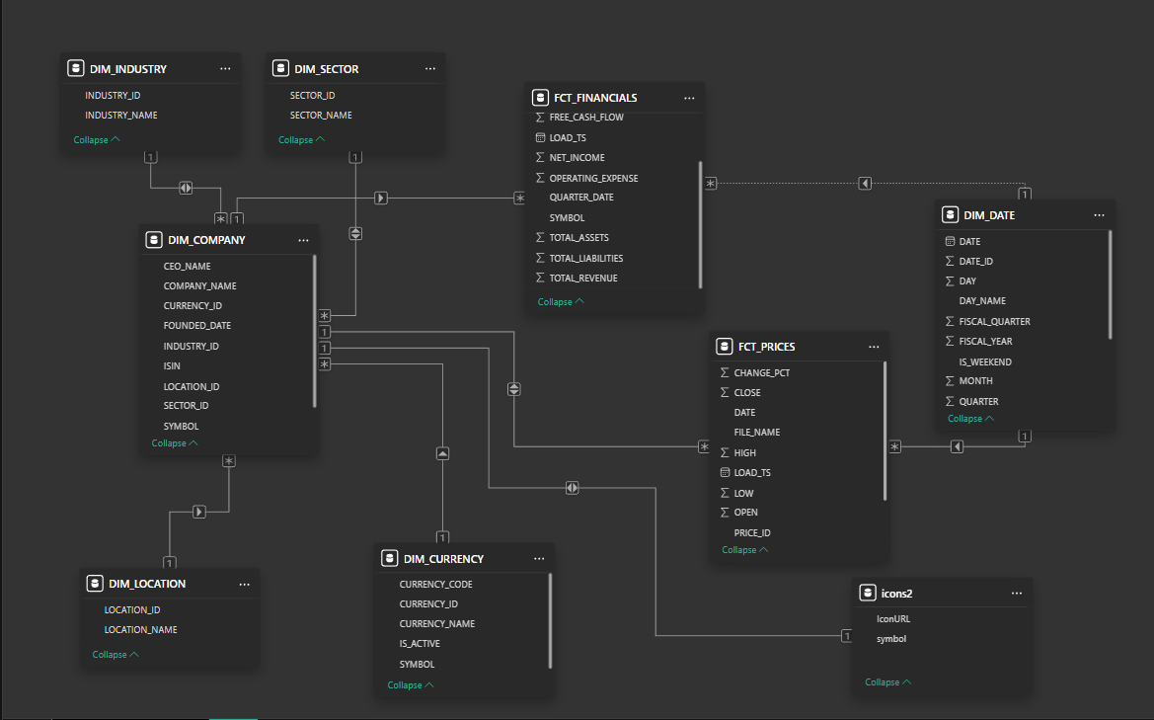
Batch Layer
Warehouse Model

Slide 18

Historical Insights
1. Price-Based Insights
a- Top & Bottom Performers
Best-returning stocks over the year
Worst-performing stocks
How many companies were positive vs negative
b- Volatility Leaders
Stocks with the highest 1-year volatility
Stocks with the lowest volatility)
c- Momentum Analysis
Weekly/Monthly momentum
% of stocks trending up vs down
Identify periods where momentum shifted

Slide 19
Historical Insights
2. Volume & Liquidity Insights
A-Volume Spikes
Days with unusually high volume (z-score > 3)
Patterns: Do volume spikes precede price jumps?
B-Liquidity Ranking
Most traded stocks
Least traded stocks (thin liquidity → higher risk)
Changes in liquidity across the year

Slide 20
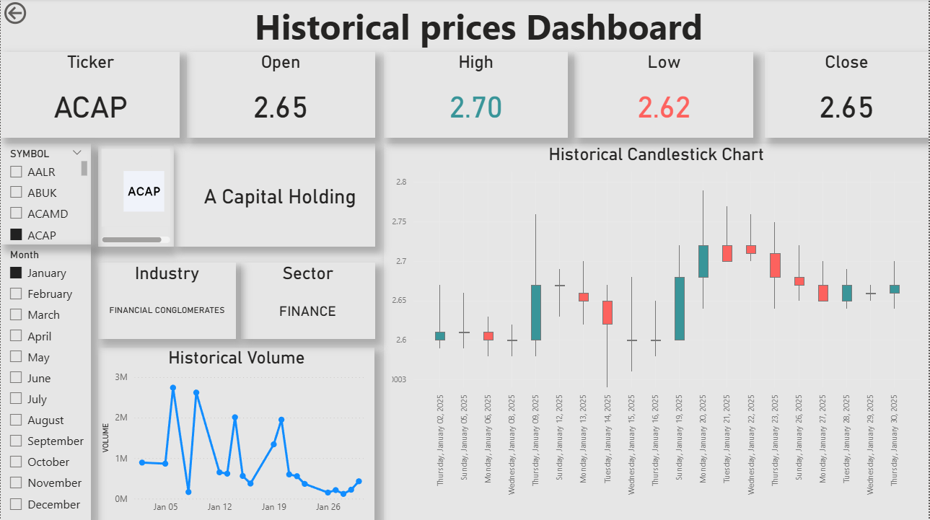

Slide 21
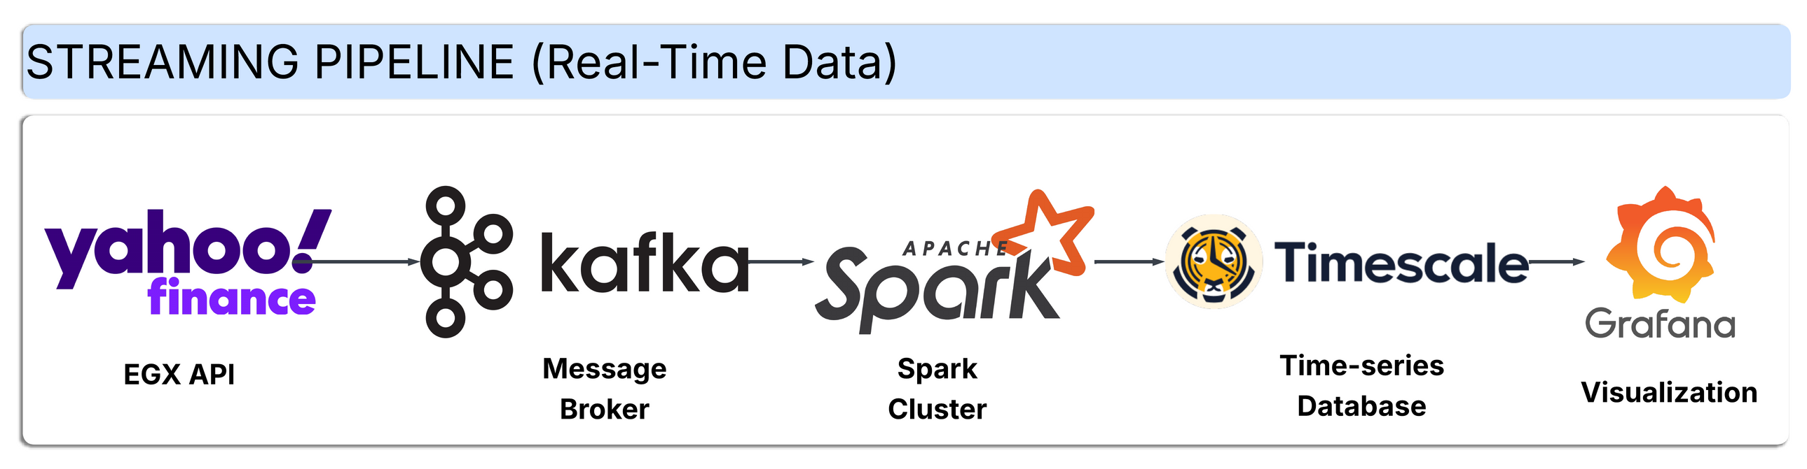
STREAMING PIPELINE ARCHITECTURE
What: Real-time data pipeline for Egyptian Stock Market (EGX)
Why: Need for live market data processing and visualization

Slide 22

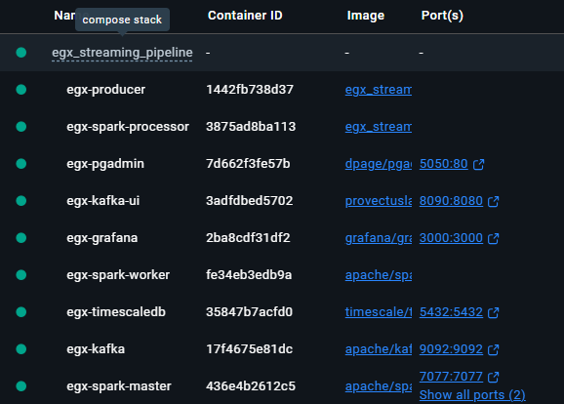
Deployment & Infrastructure
Containerization: Docker Compose with 6 services
One-command deployment: docker compose up -d --build
Benefits:
Consistent environment
Easy scaling
Quick setup and teardown

Slide 23



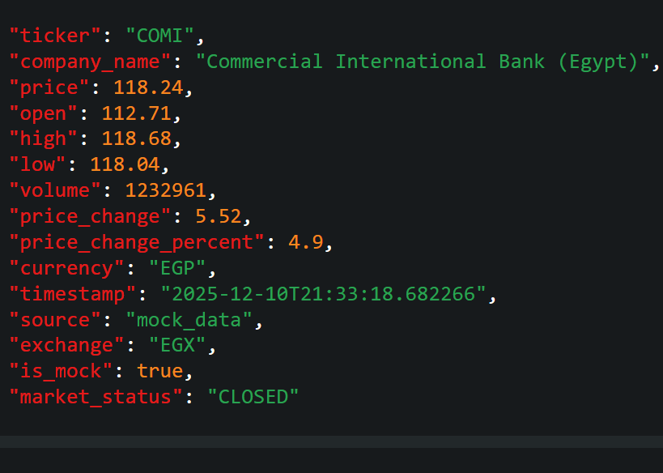
Data Ingestion Producer Component
Technology: Python with Kafka Producer, yfinance API
+
Functionality: Fetches real-time data for EGX-30 stocks (10 tickers)
Publishes JSON messages to Kafka topic egx_market_data
5 second tick intervals
Smart Features:
Auto-retry connection to Kafka (resilience)
Fallback to mock data when markets closed
Ensures demo always works

Slide 24
Why Kafka: Decoupling, scalability, fault tolerance
Message Broker - Apache Kafka
Smart Features:
Zookeeper for coordination
Kafka broker on port 9093
Topic: egx_market_data
Benefits:
Producer/consumer independence
Message buffering
Stream replay capability

Slide 25

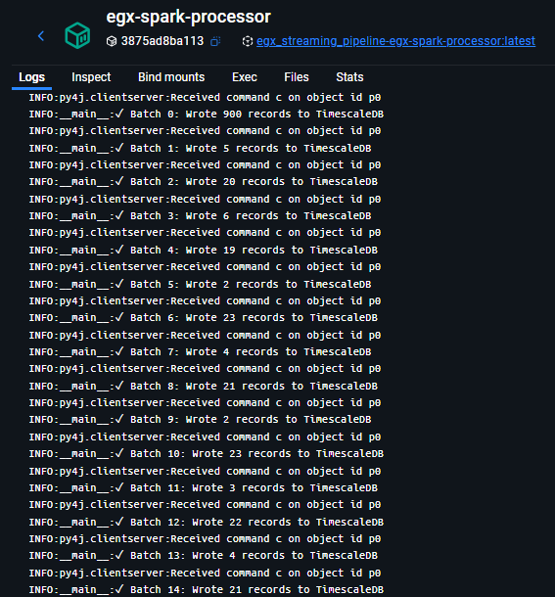
Stream Processing - PySpark
Technology: Standalone PySpark with Structured Streaming
Processing Steps:
Read stream from Kafka
Parse JSON schema (ticker, price, volume, timestamp)
Apply transformations:
Data cleaning
1-minute Simple Moving Average (SMA)
Windowed aggregations
Write to TimescaleDB in micro-batches
Key Features:
Real-time analytics on streaming data
Stateful processing with windowing
Fault-tolerant checkpointing

Slide 26

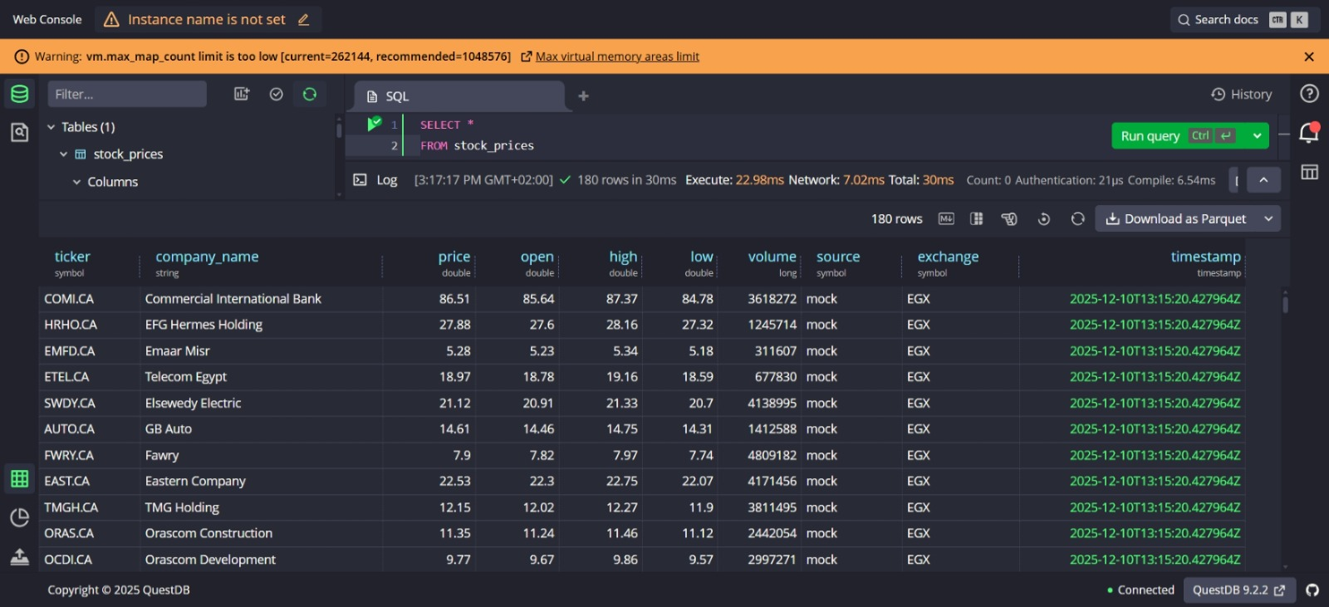
Storage - Timescale Database
Why TimescaleDB: Optimized time-series database
Features:
High-speed writes (critical for real-time)
Efficient time-based queries
Built-in retention policies
Schema:
Measurement: stock_price
Tags: ticker
Fields: price, volume, sma_1min
Timestamp: event time

Slide 27


VISUALIZATION - GRAFANA DASHBOARD
Features:
Real-time stock prices (time series)
Trading volume bars
Moving averages
Auto-refresh every 5 seconds

Slide 28
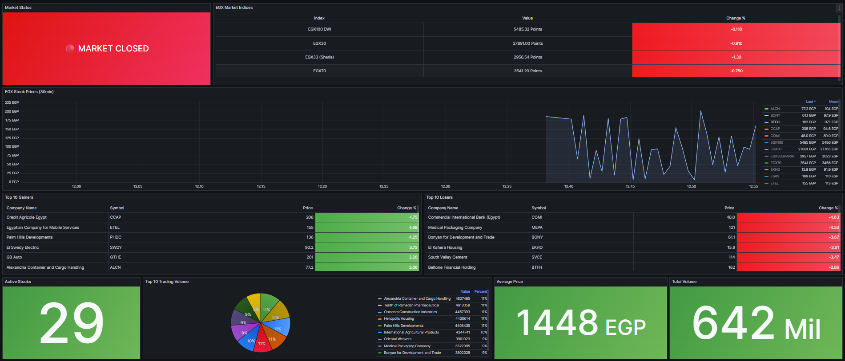
STREAMING DASHBOARD

Slide 29




Build a Public EGX API
Machine Learning for Prediction
Develop and maintain a reliable, well-documented API for Egyptian Stock Exchange data, since no official or trustworthy API currently exists.
Implement ML models to predict stock prices, analyze trends, and provide advanced analytics for investors and researchers.
Unified EGX
System
LLM-Powered EGX Chatbot
Cross-Platform Integration
Create a large language model chatbot that can answer user questions about EGX stocks, indices, and market trends using real-time and historical data.
Package all components (data pipeline, analytics, dashboards, chatbot) into a unified cross-platform application (web, desktop, mobile) for seamless user experience.

Slide 30
Thank You!
Information Technology Institute - ITI
Data Engineering Track - R1 2025

